Slide 1

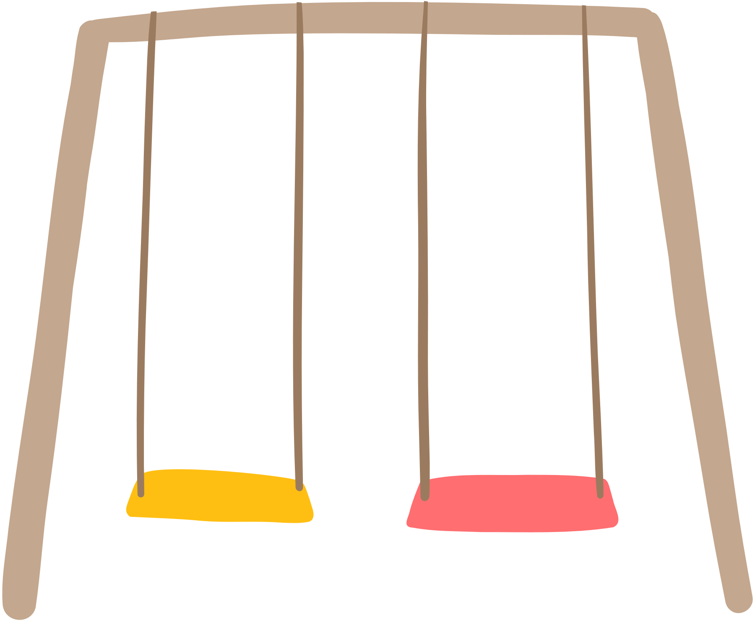

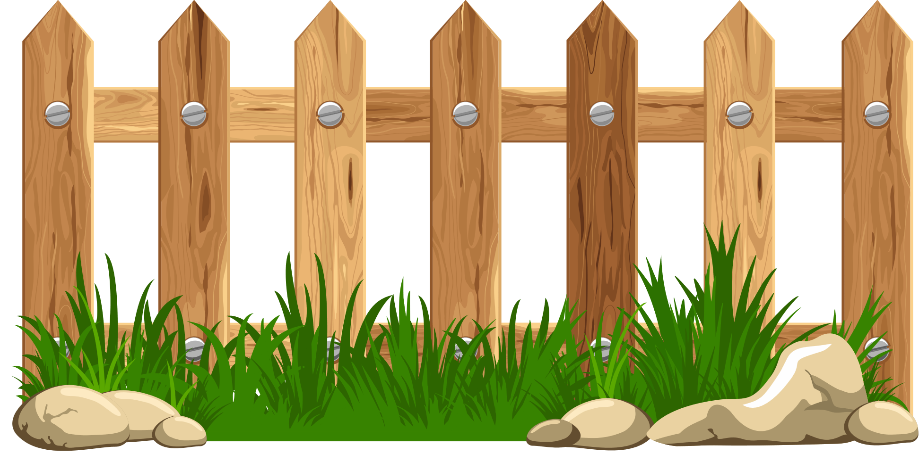
AT THE PLAYGROUND

Slide 2
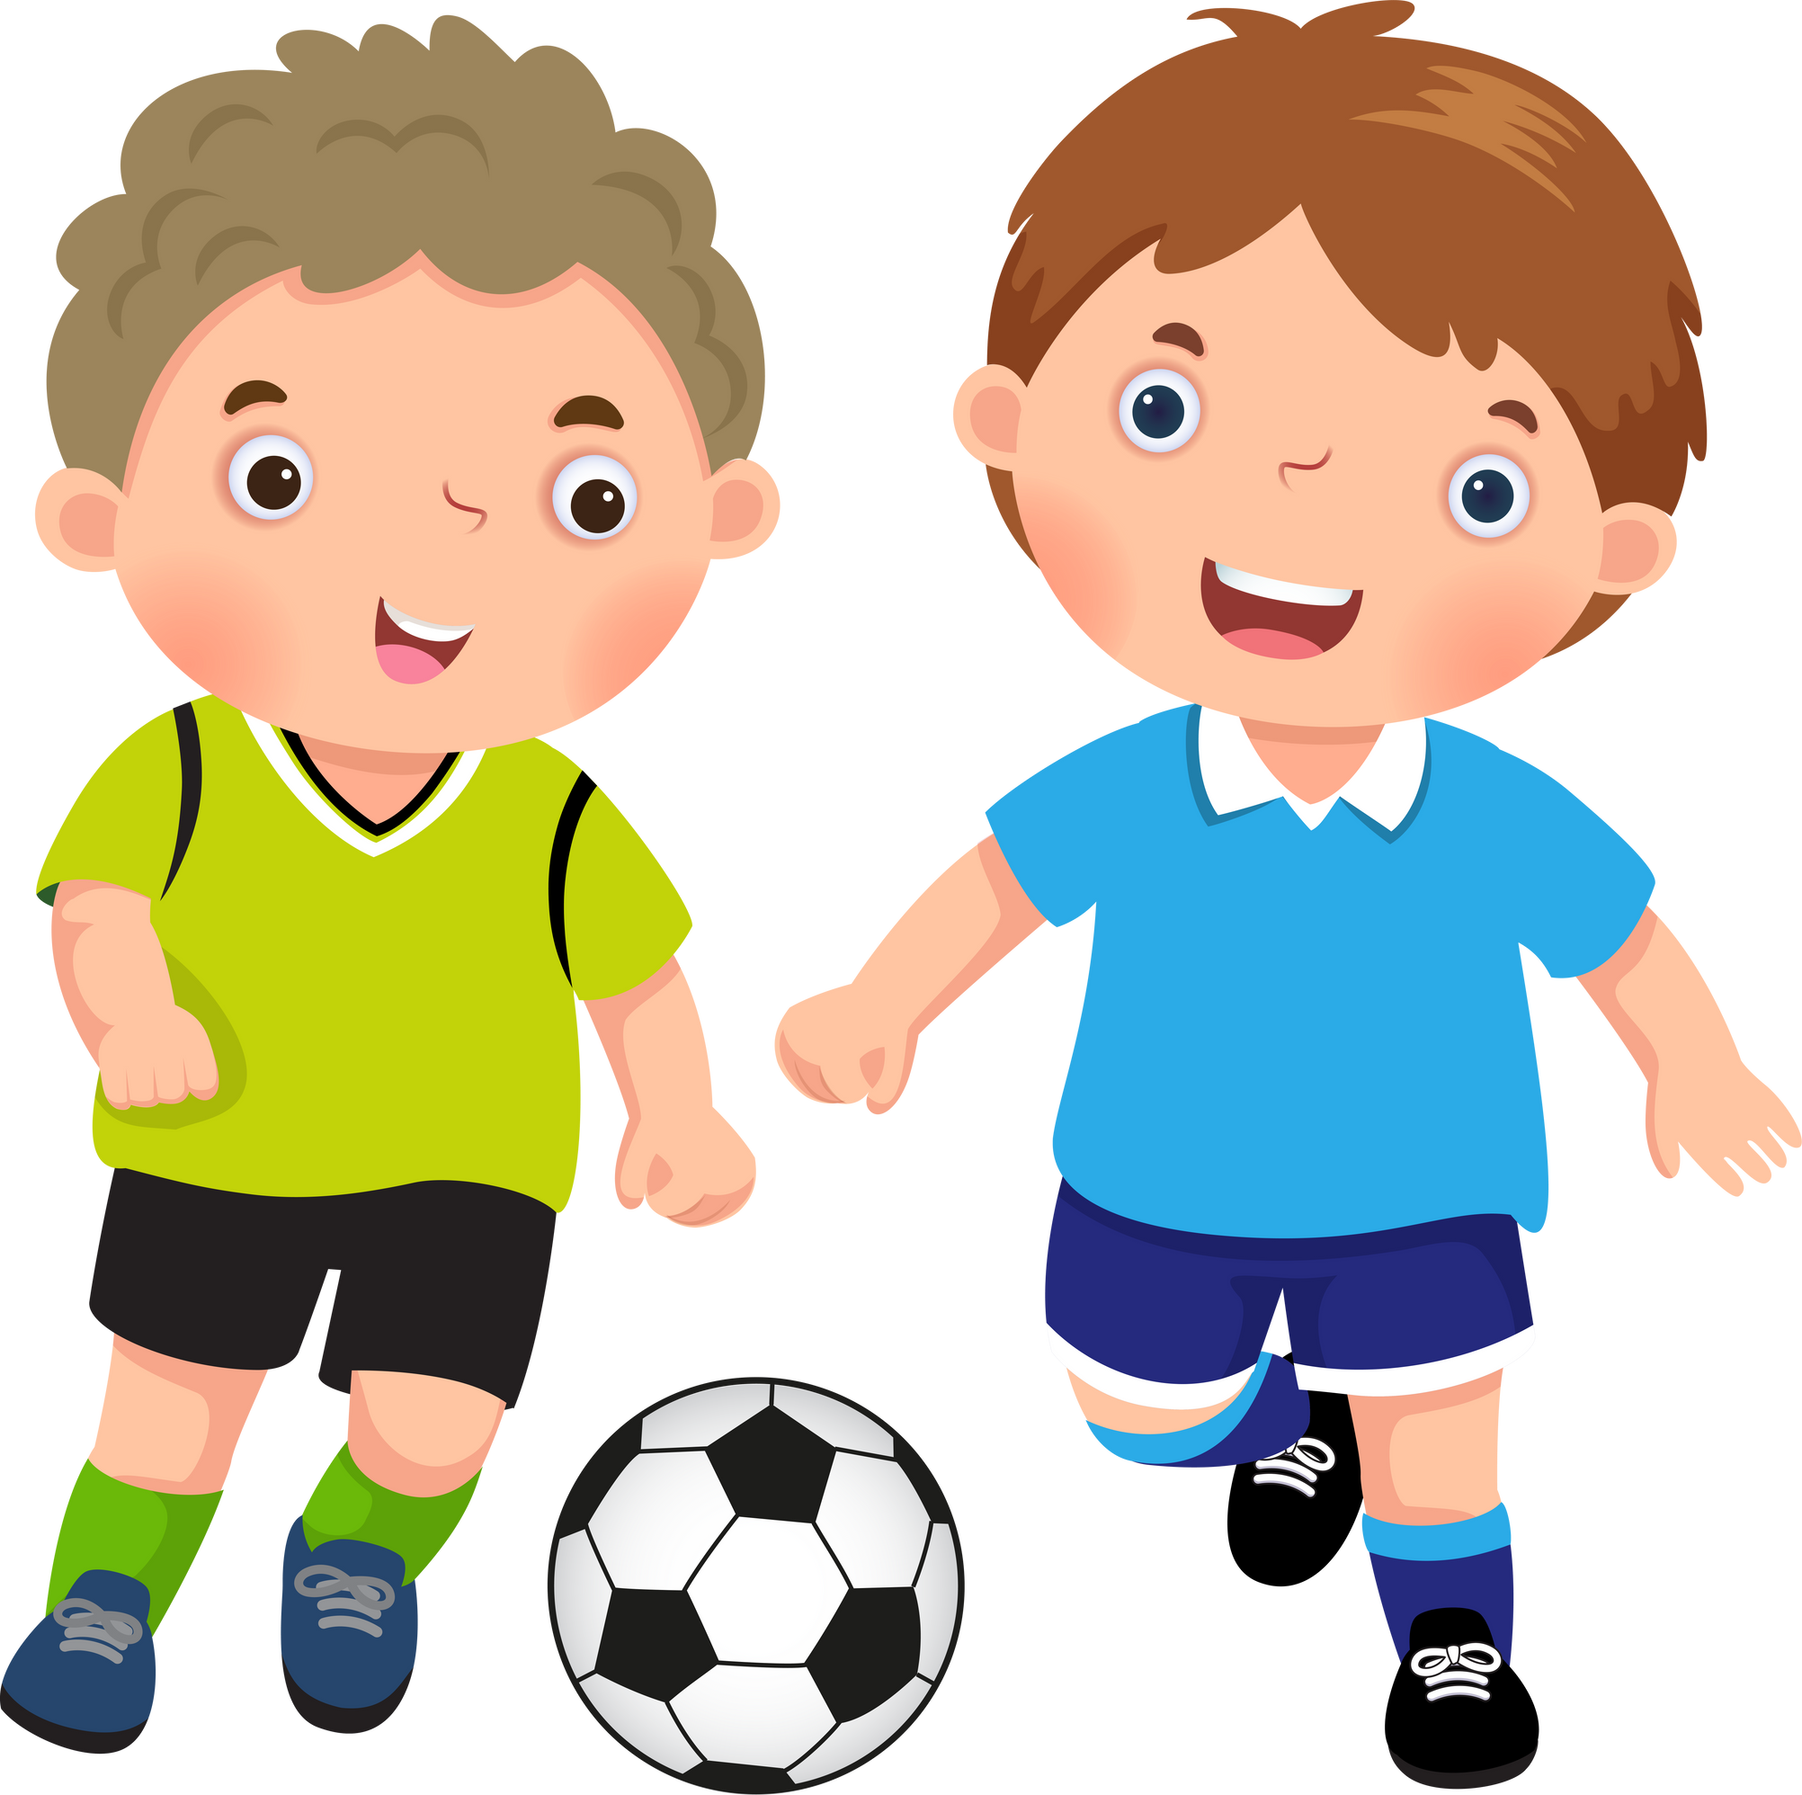



Slide 3
play football

Slide 4
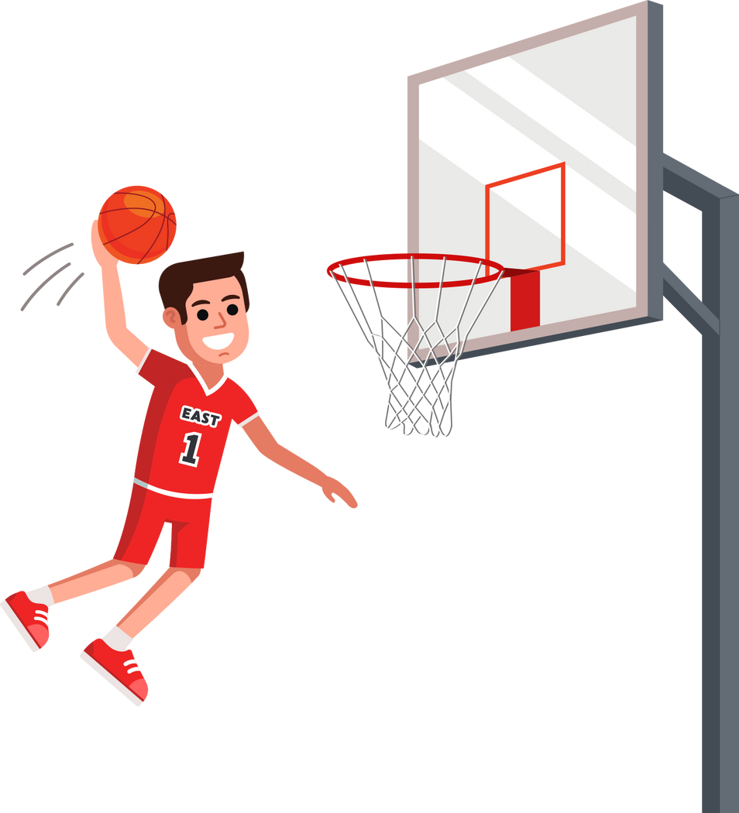

Slide 5
play basketball

Slide 6
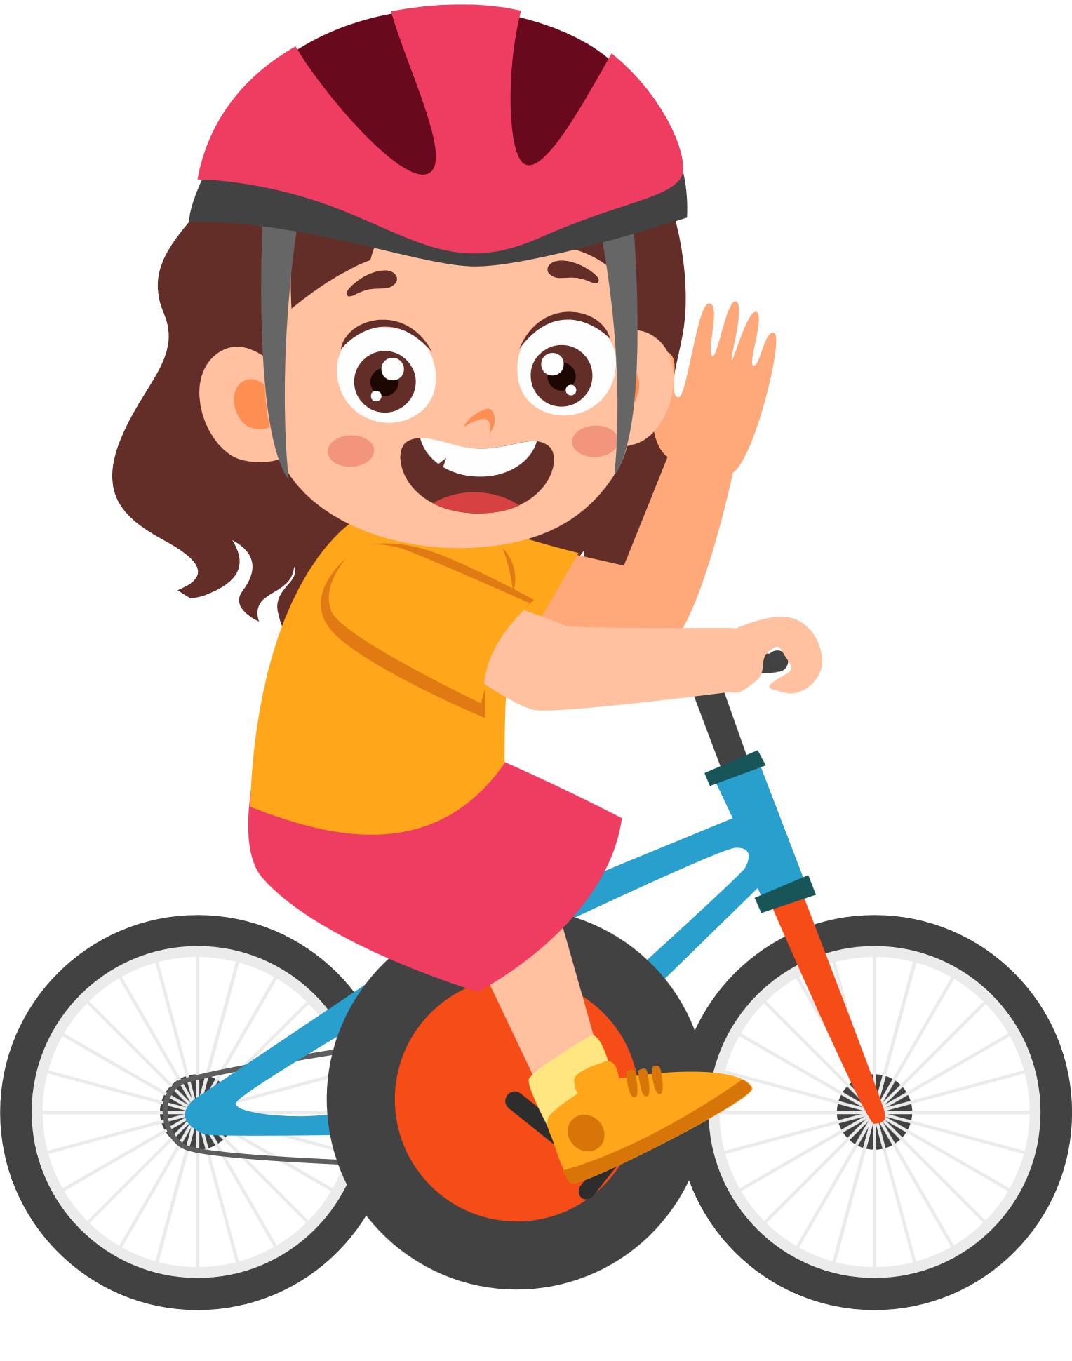

Slide 7
ride a bike

Slide 8
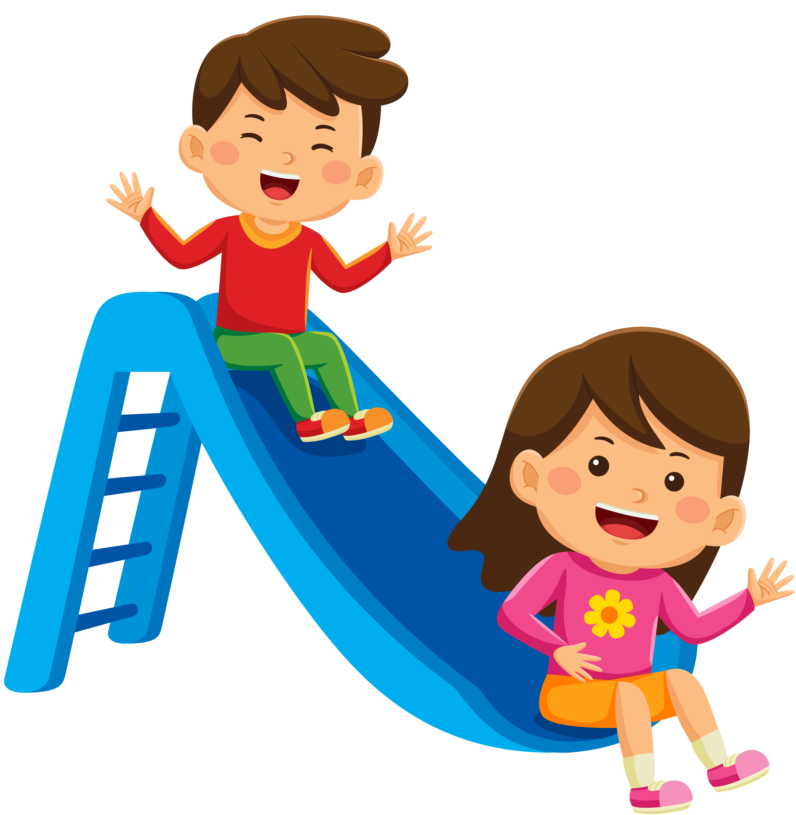

Slide 9
slide

Slide 10
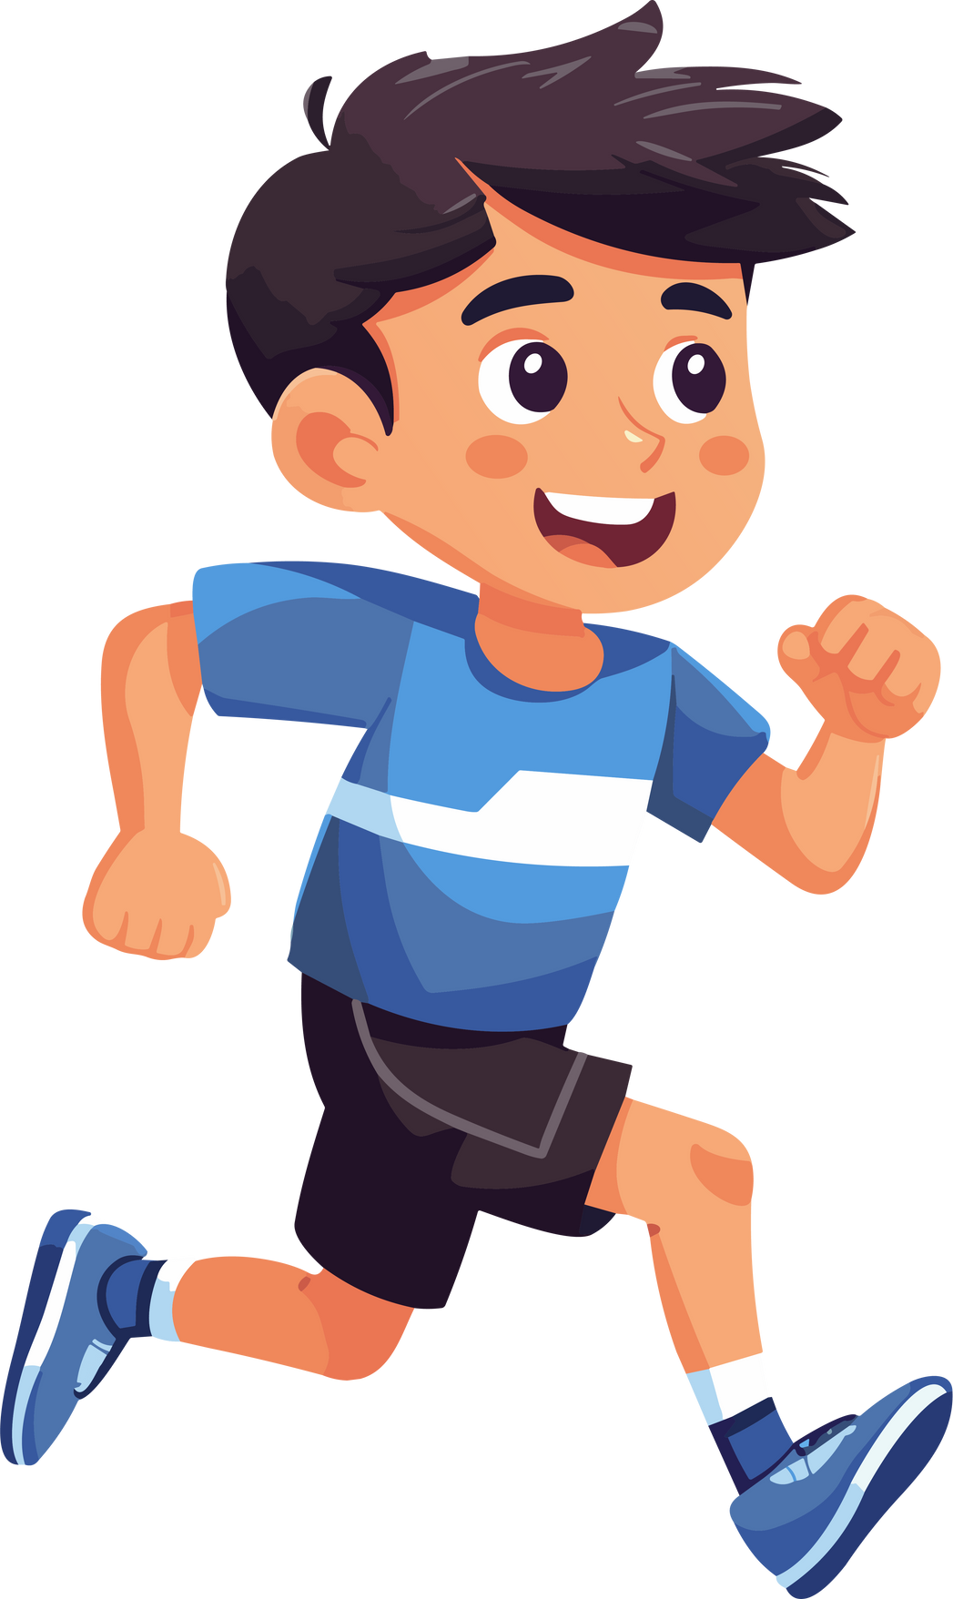

Slide 11
run

Slide 12
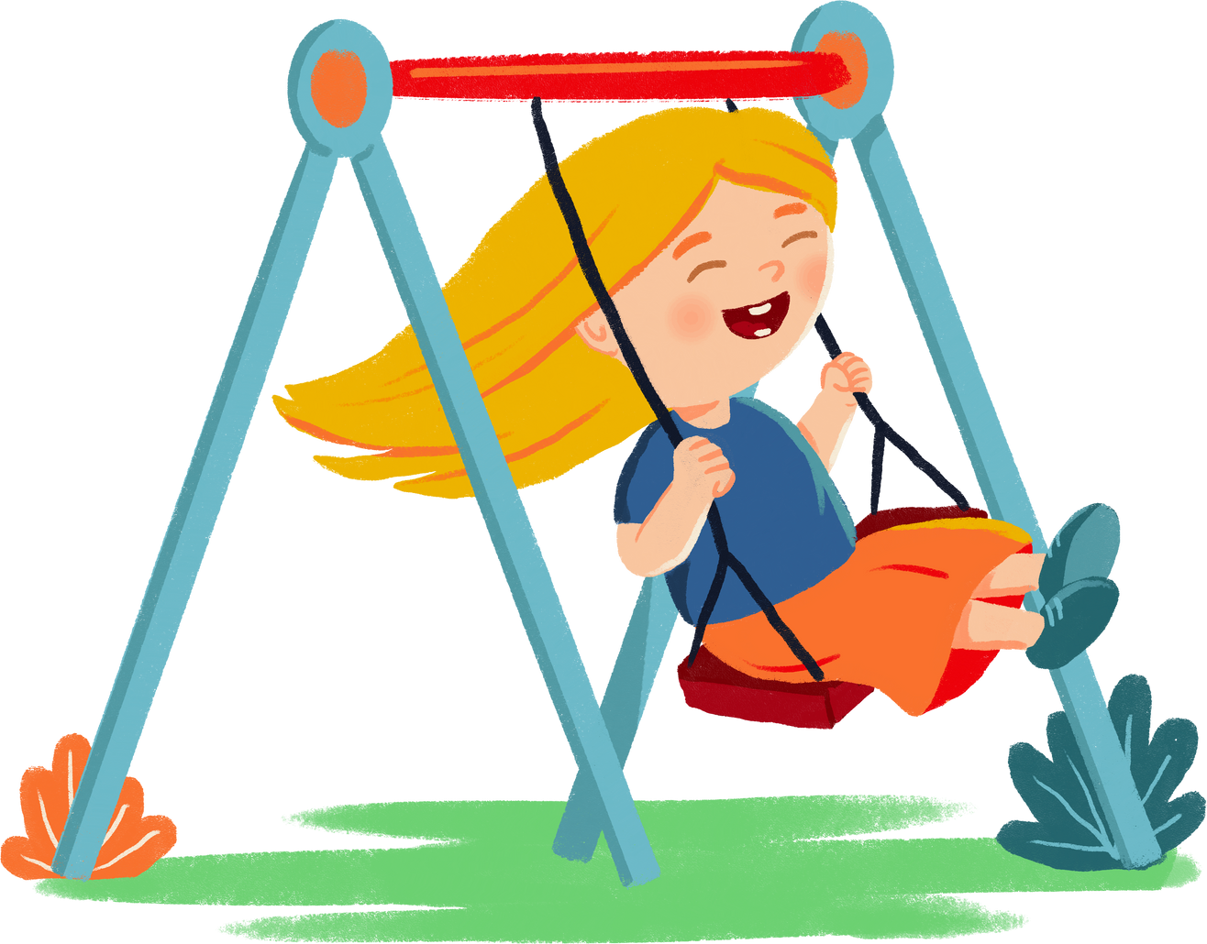

Slide 13
swing

Slide 14
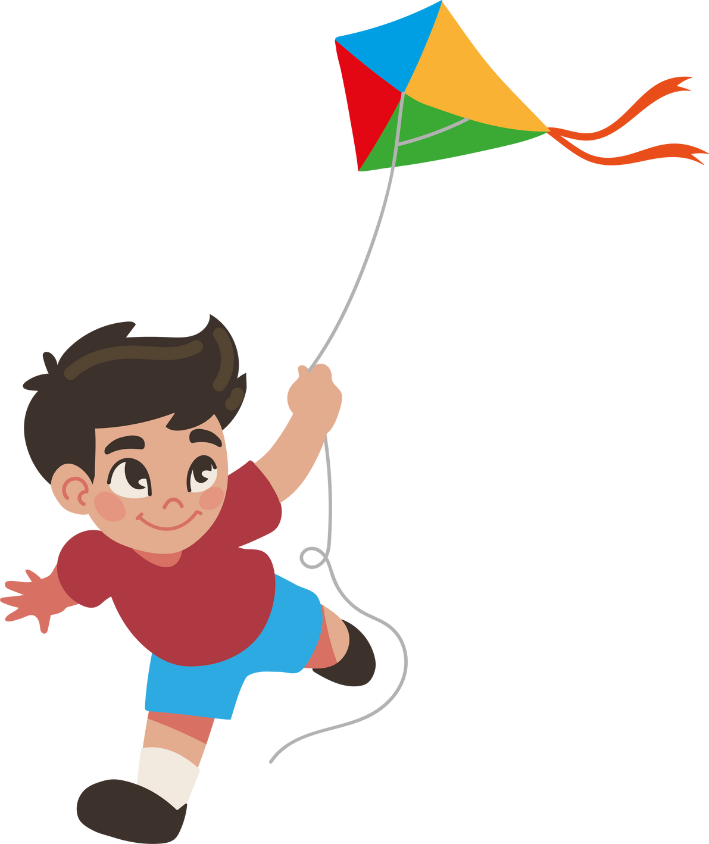

Slide 15
fly a kite

Slide 16
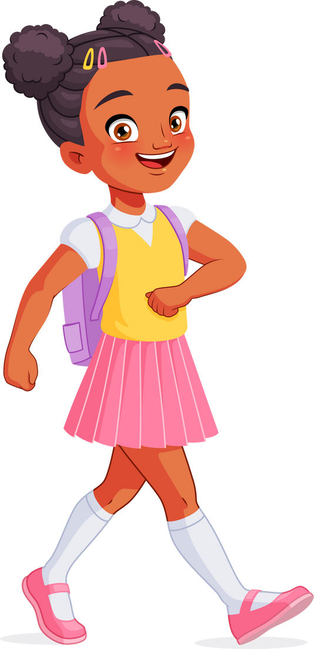

Slide 17
walk

Slide 18
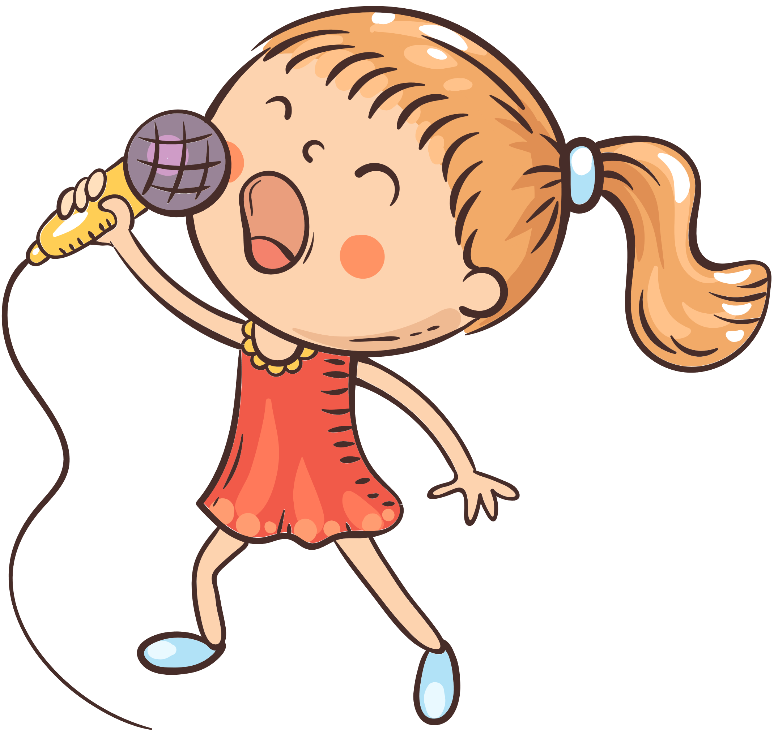

Slide 19
sing

Slide 20
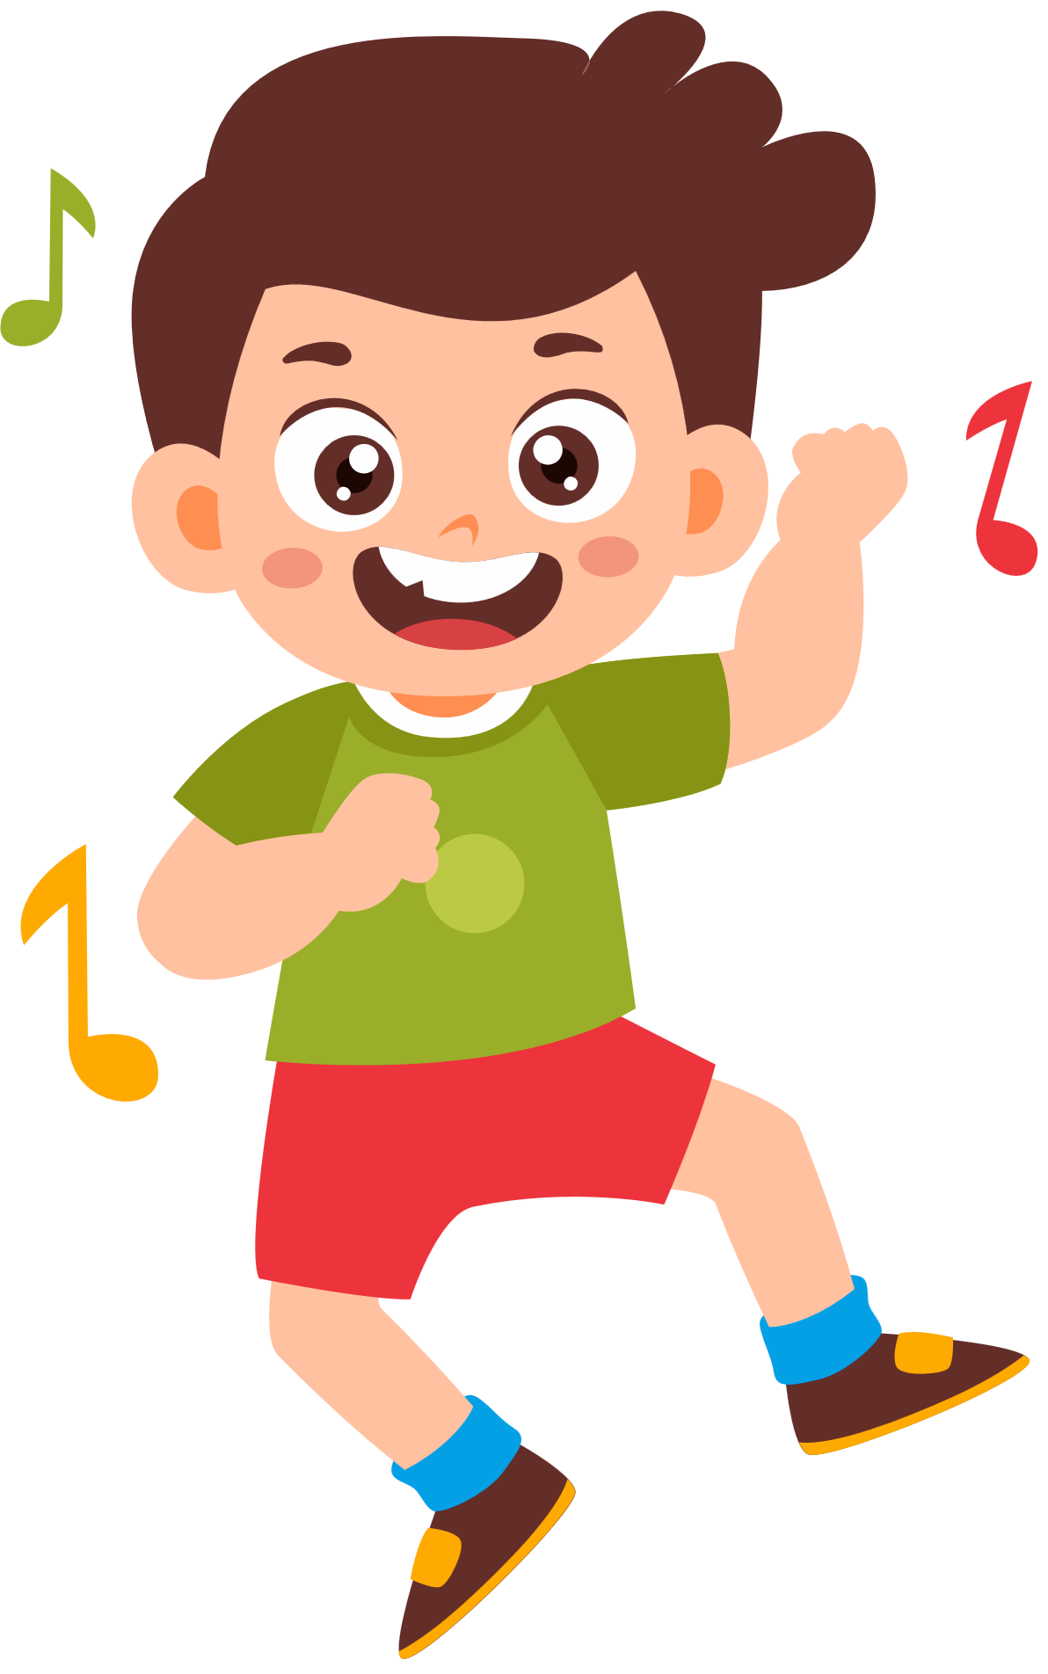

Slide 21
dance

Slide 22
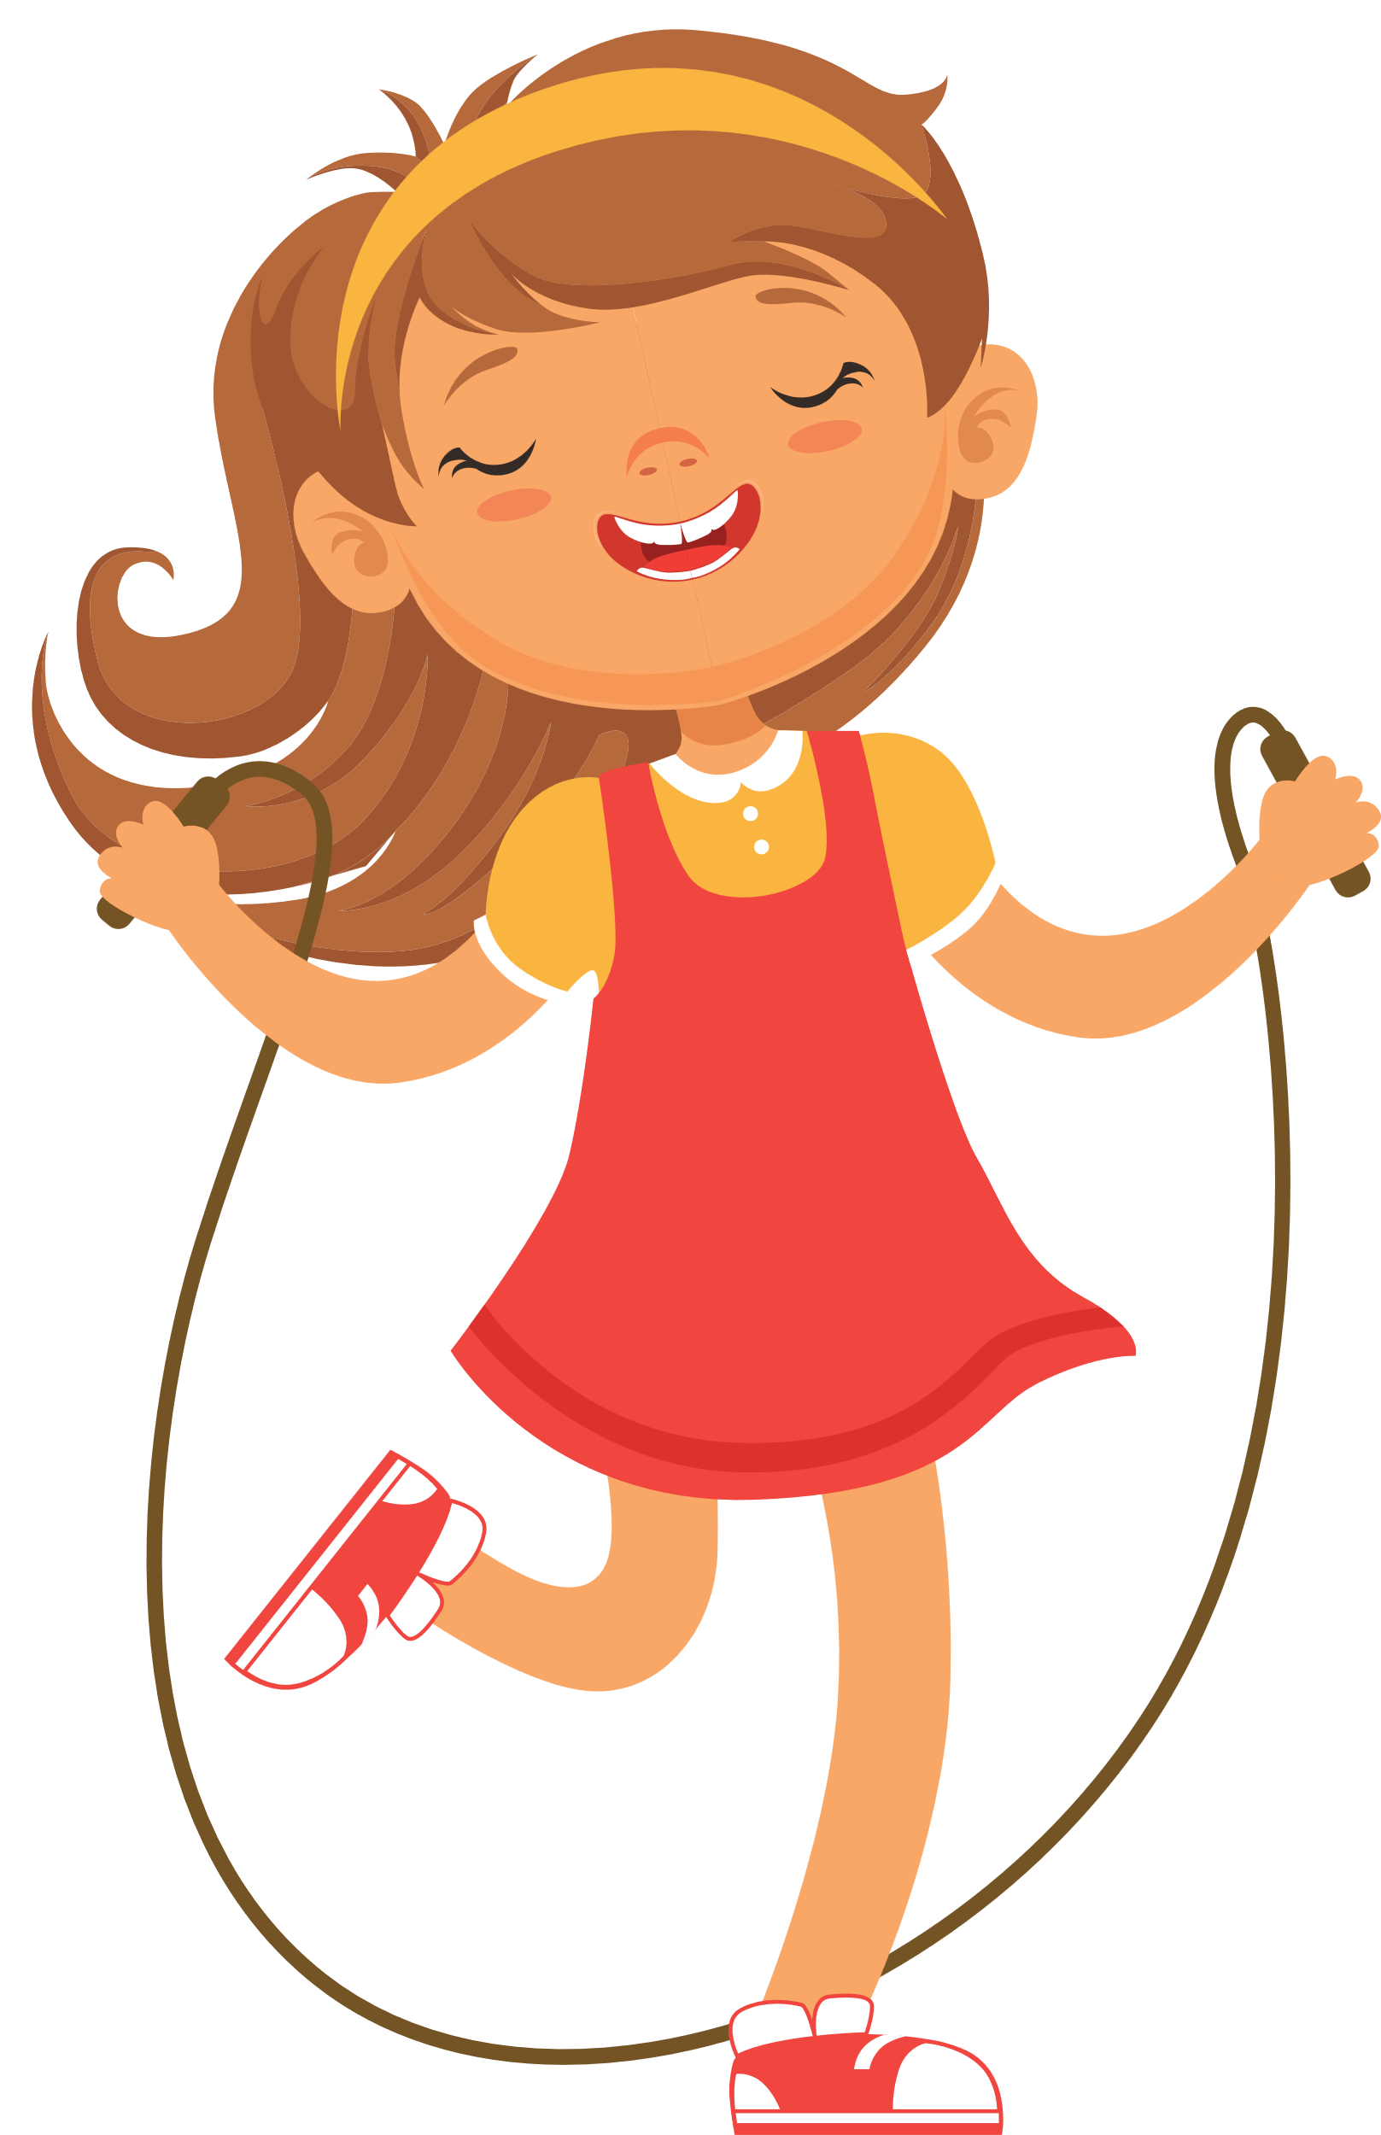

Slide 23
skip rope

Slide 24
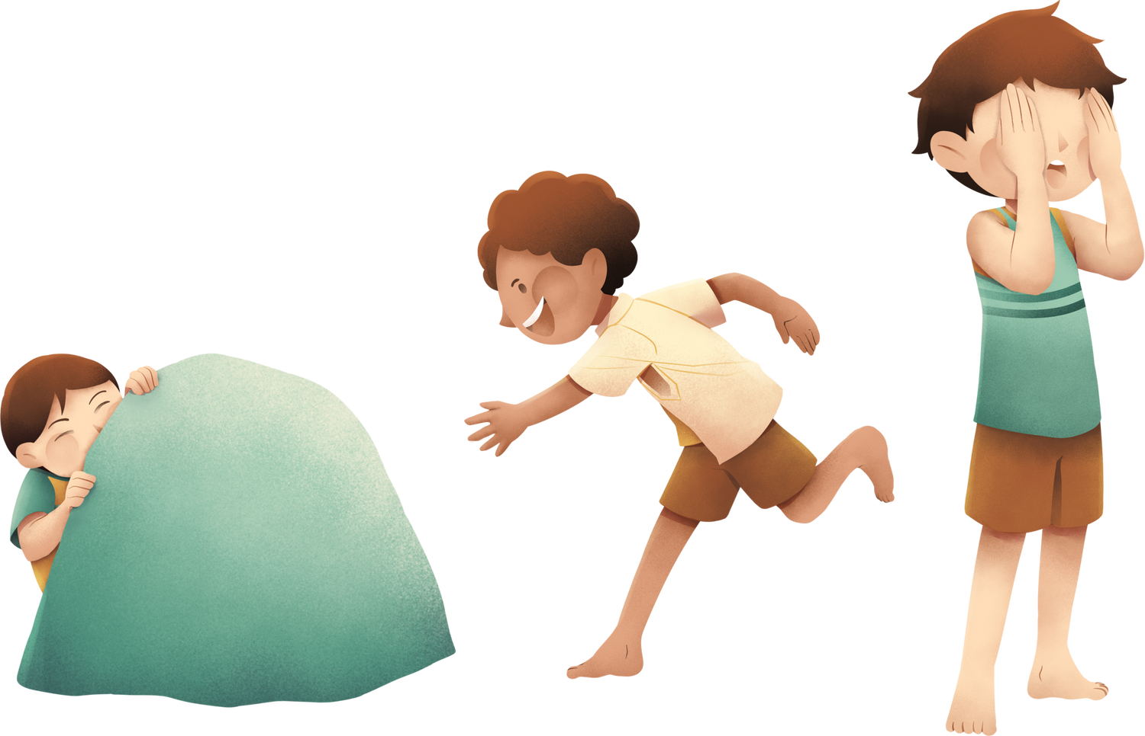

Slide 25
play hide and seek

Slide 26
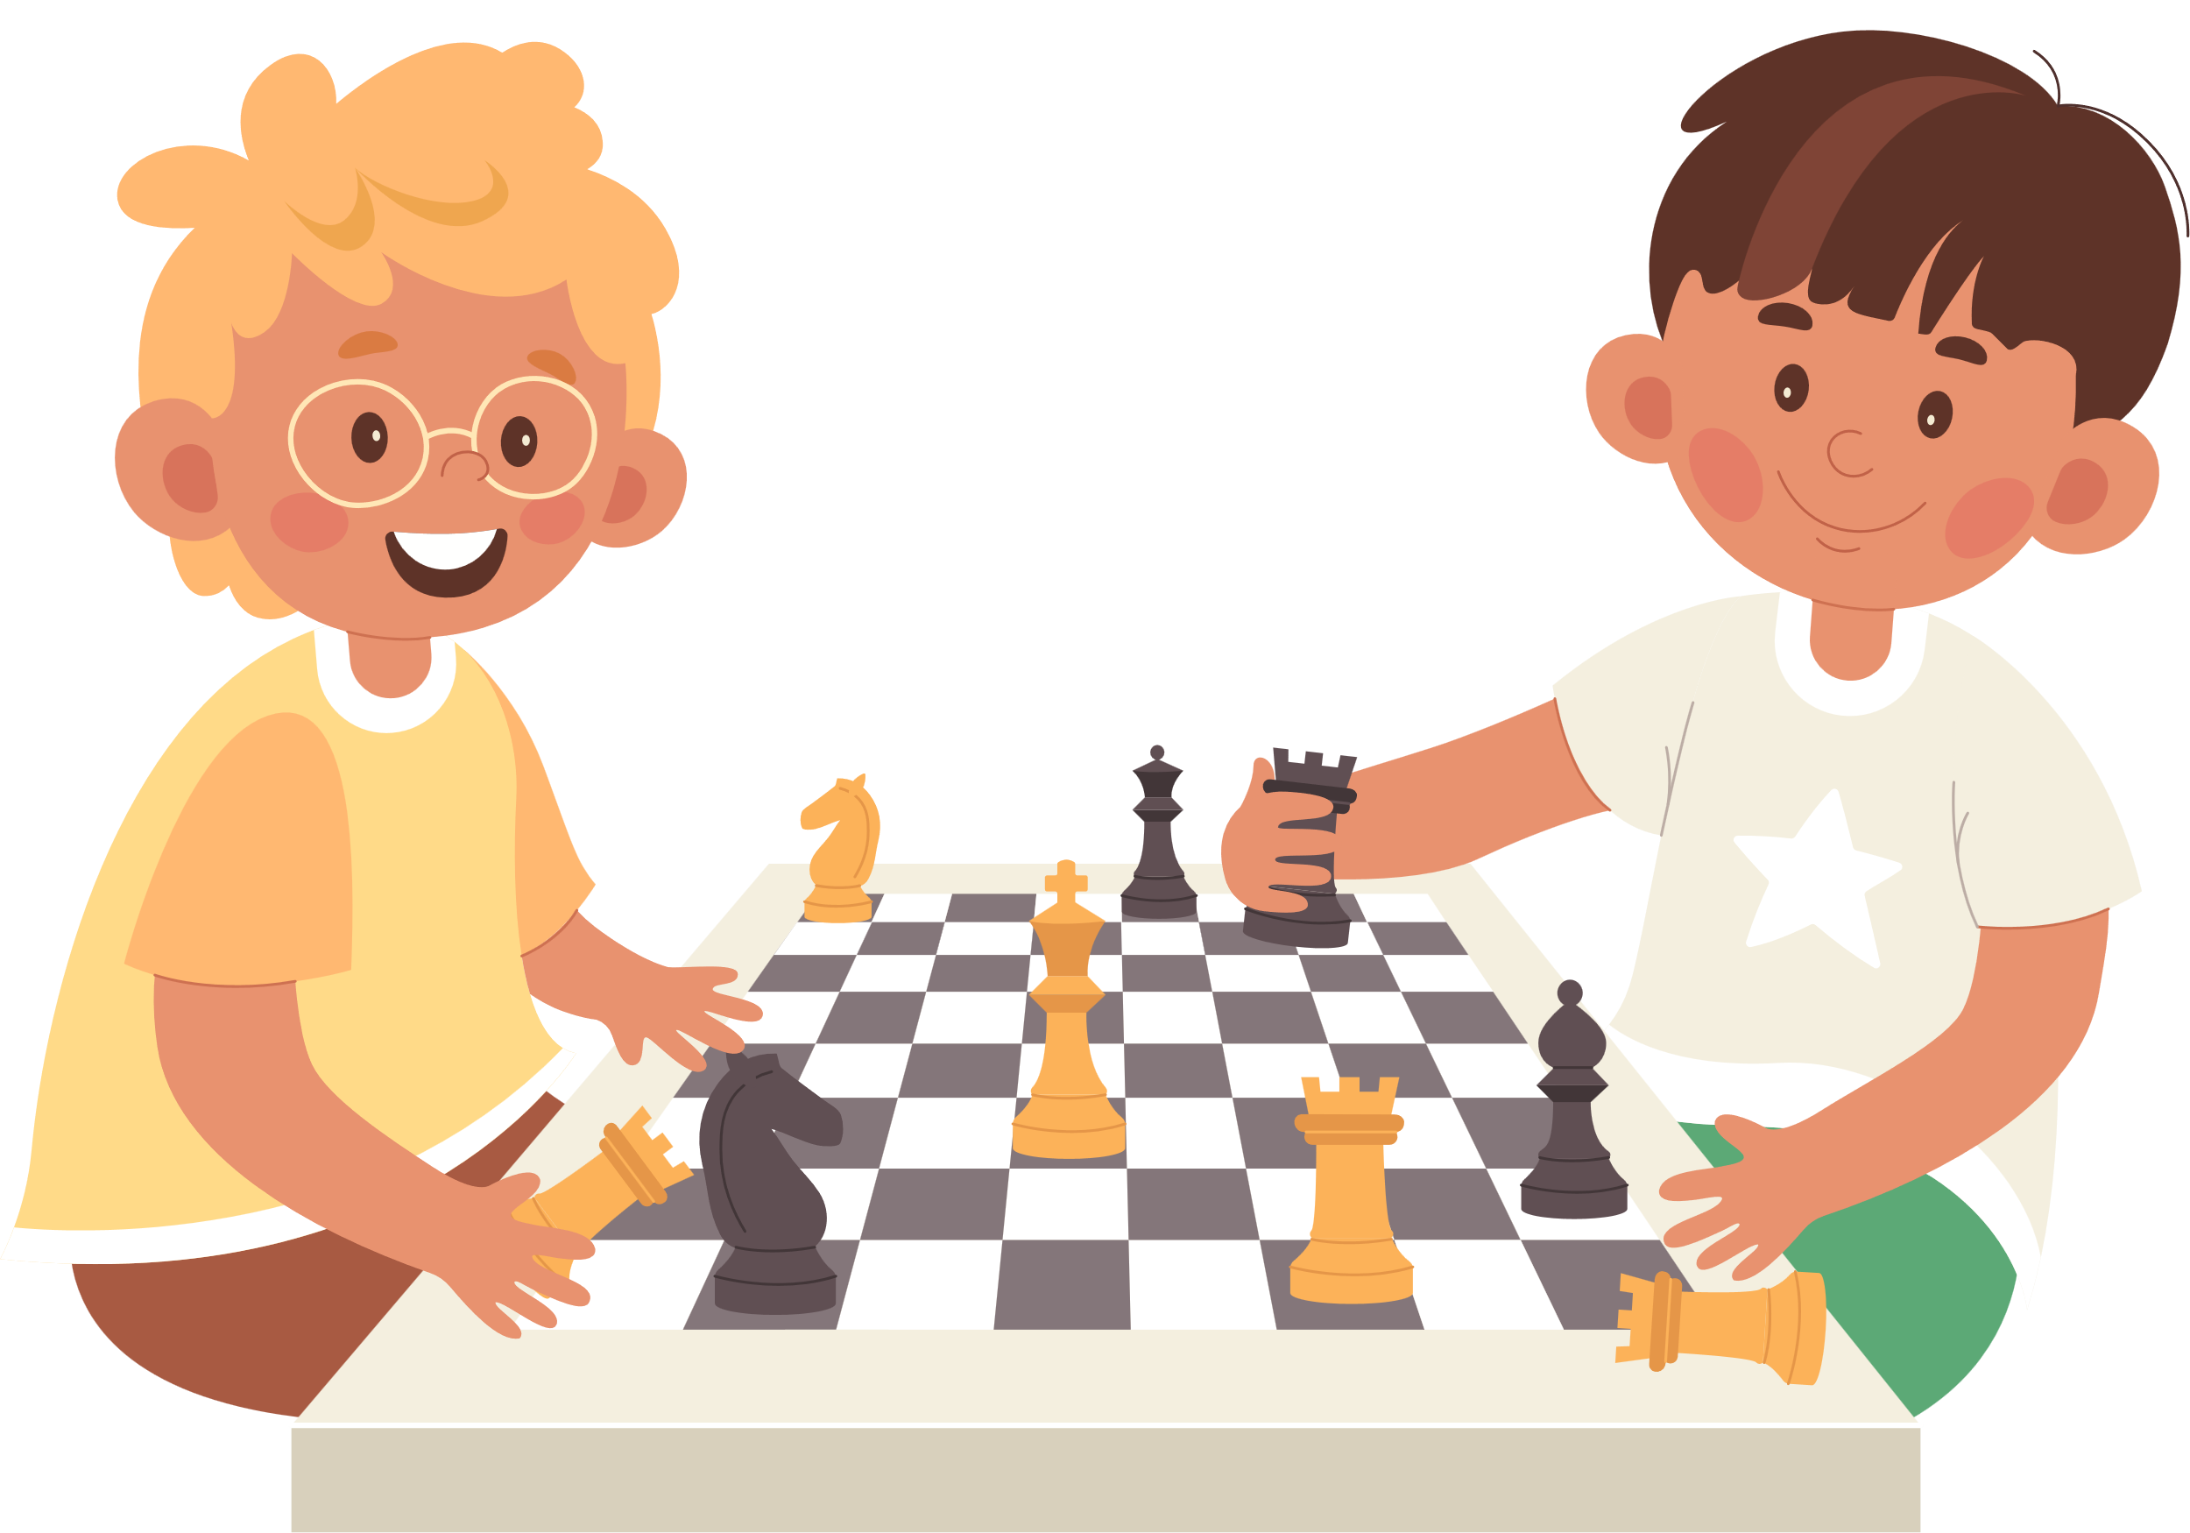

Slide 27
play chess

