Slide 1


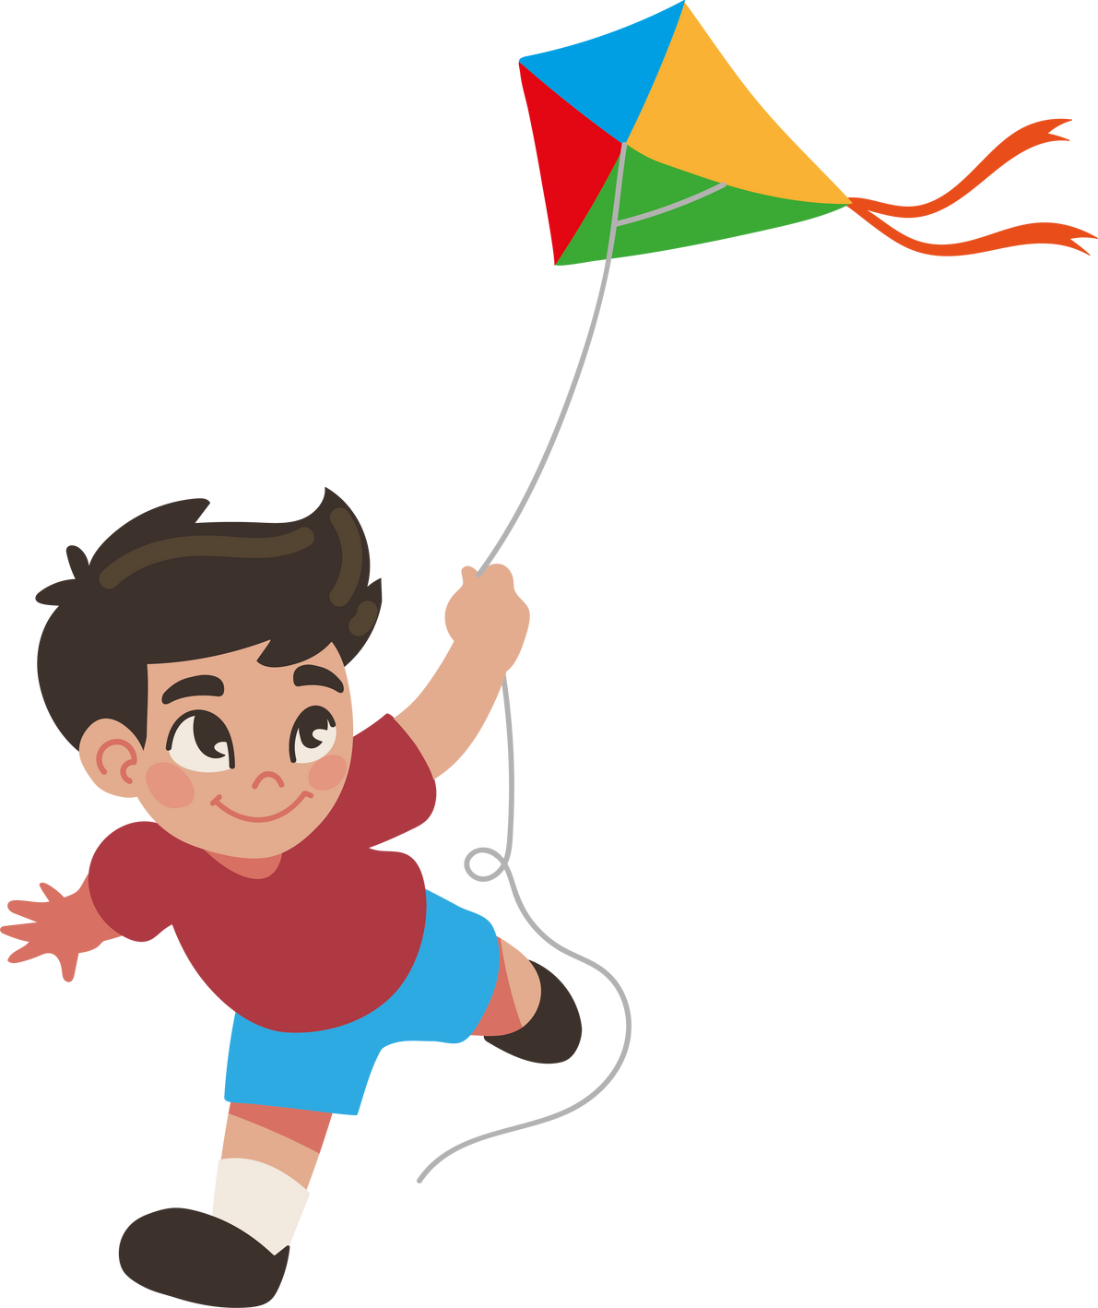
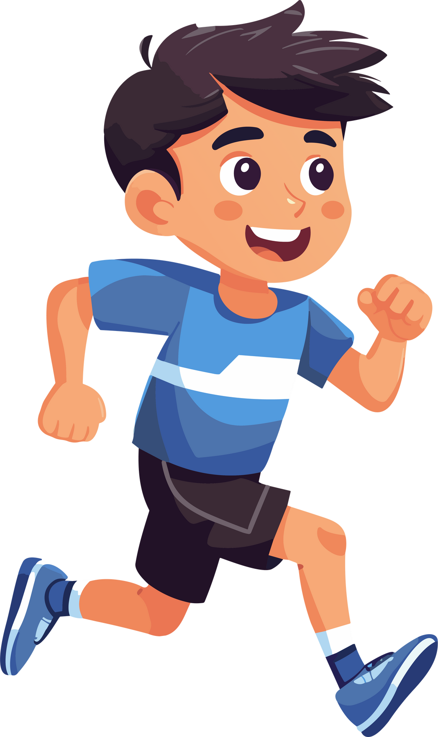
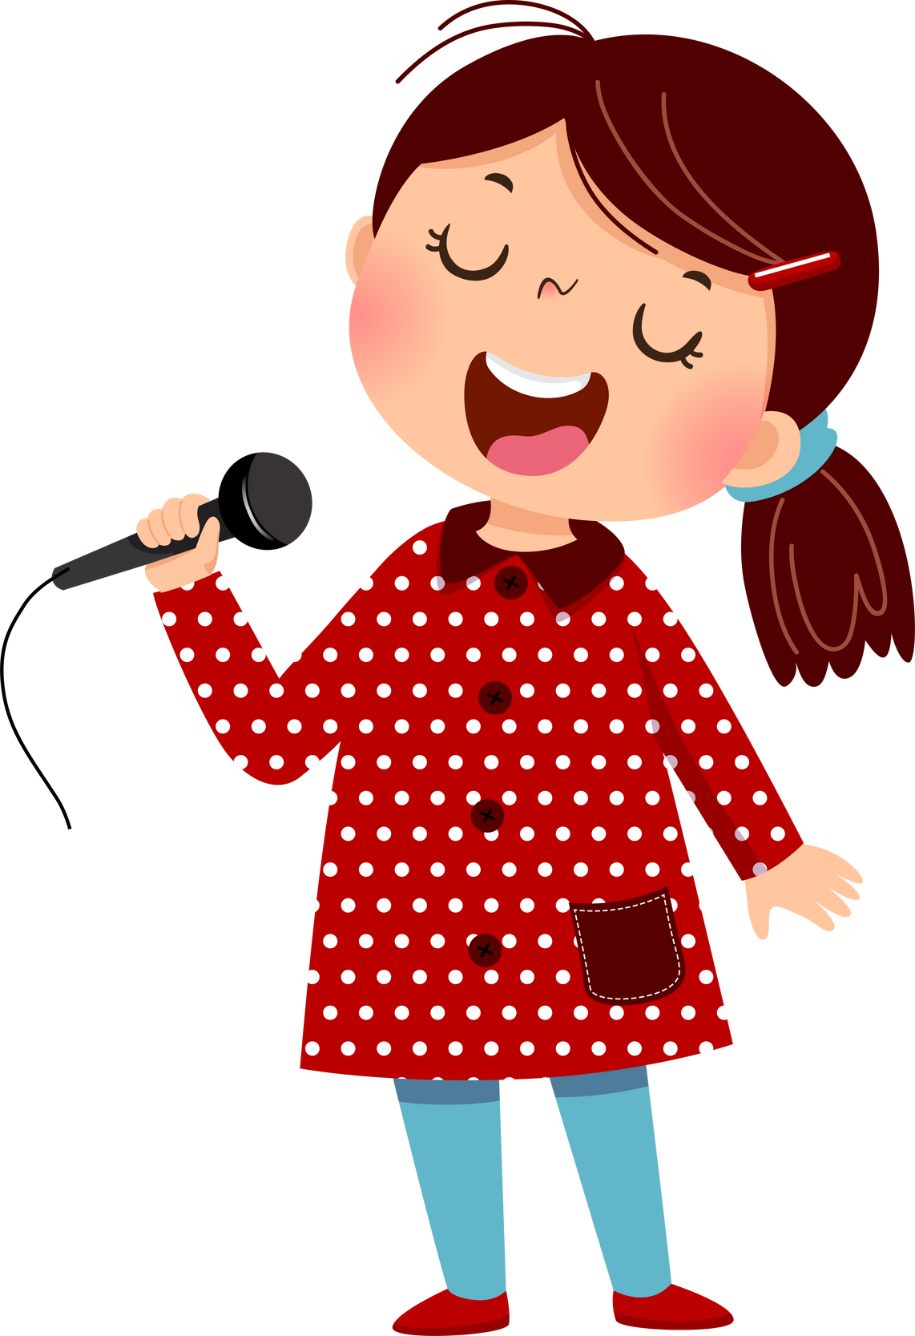
Do you ...?

Slide 2
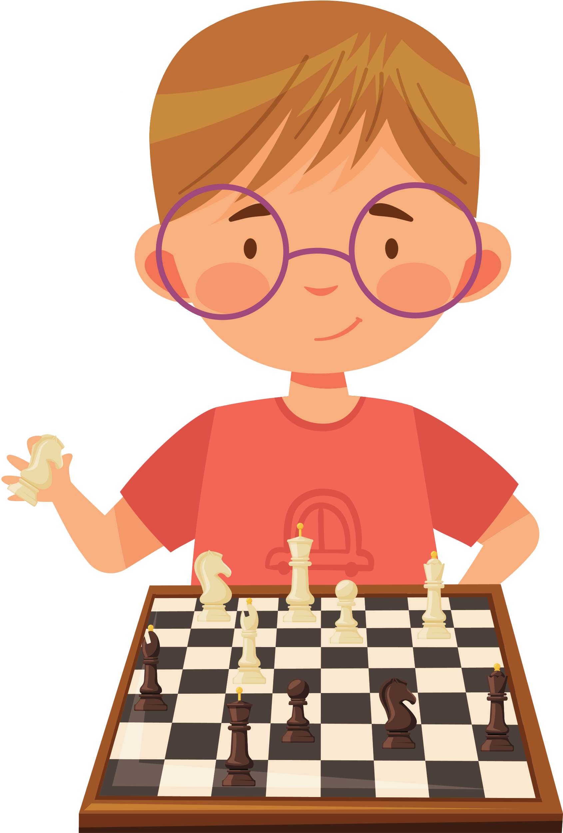
Do you play chess ?

Slide 3

Do you play chess ?
Yes, I do.

Slide 4
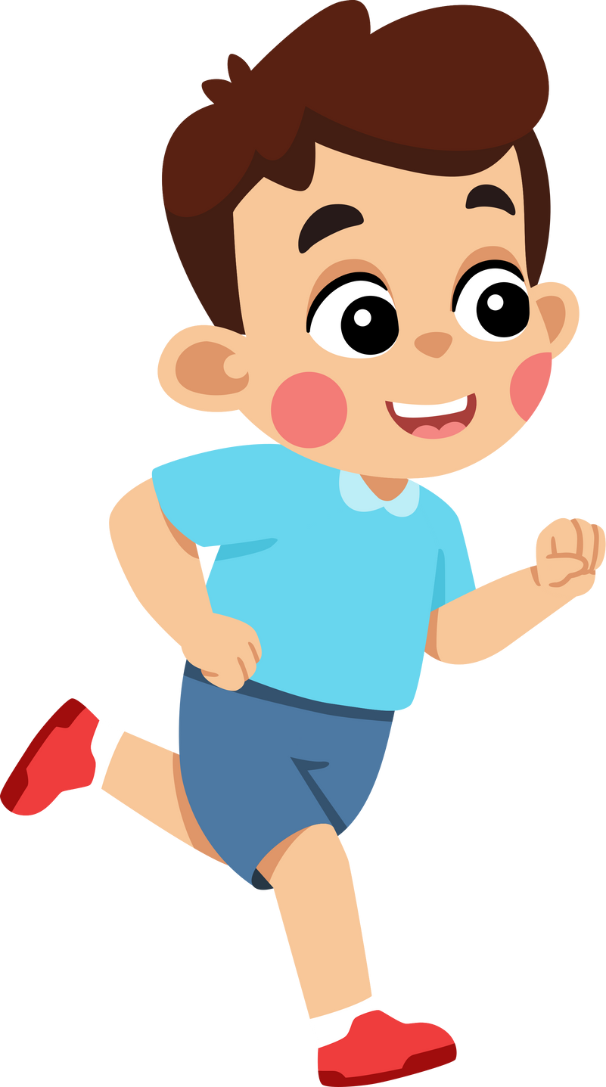
Do you run ?

Slide 5
Do you run ?
Yes, I do.

Slide 6
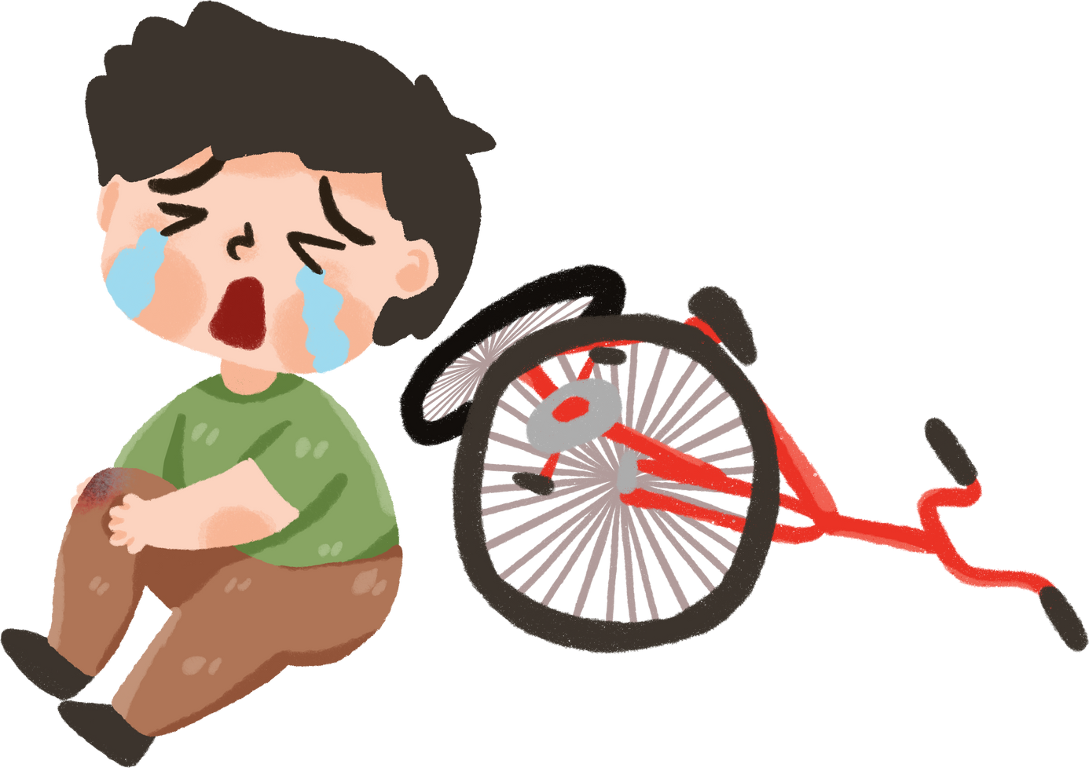
Do you ride a bike ?

Slide 7


Do you ride a bike ?
No, I don’t.

Slide 8
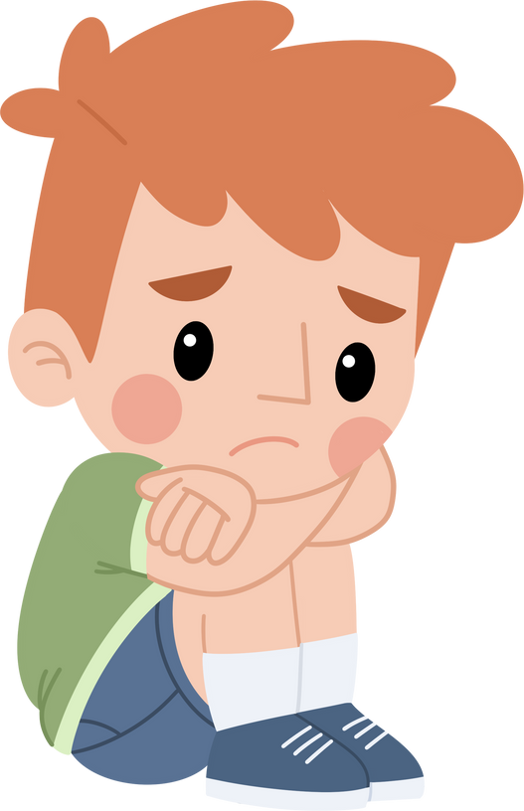

Do you fly a kite ?

Slide 9
Do you fly a kite ?
No, I don’t.

Slide 10
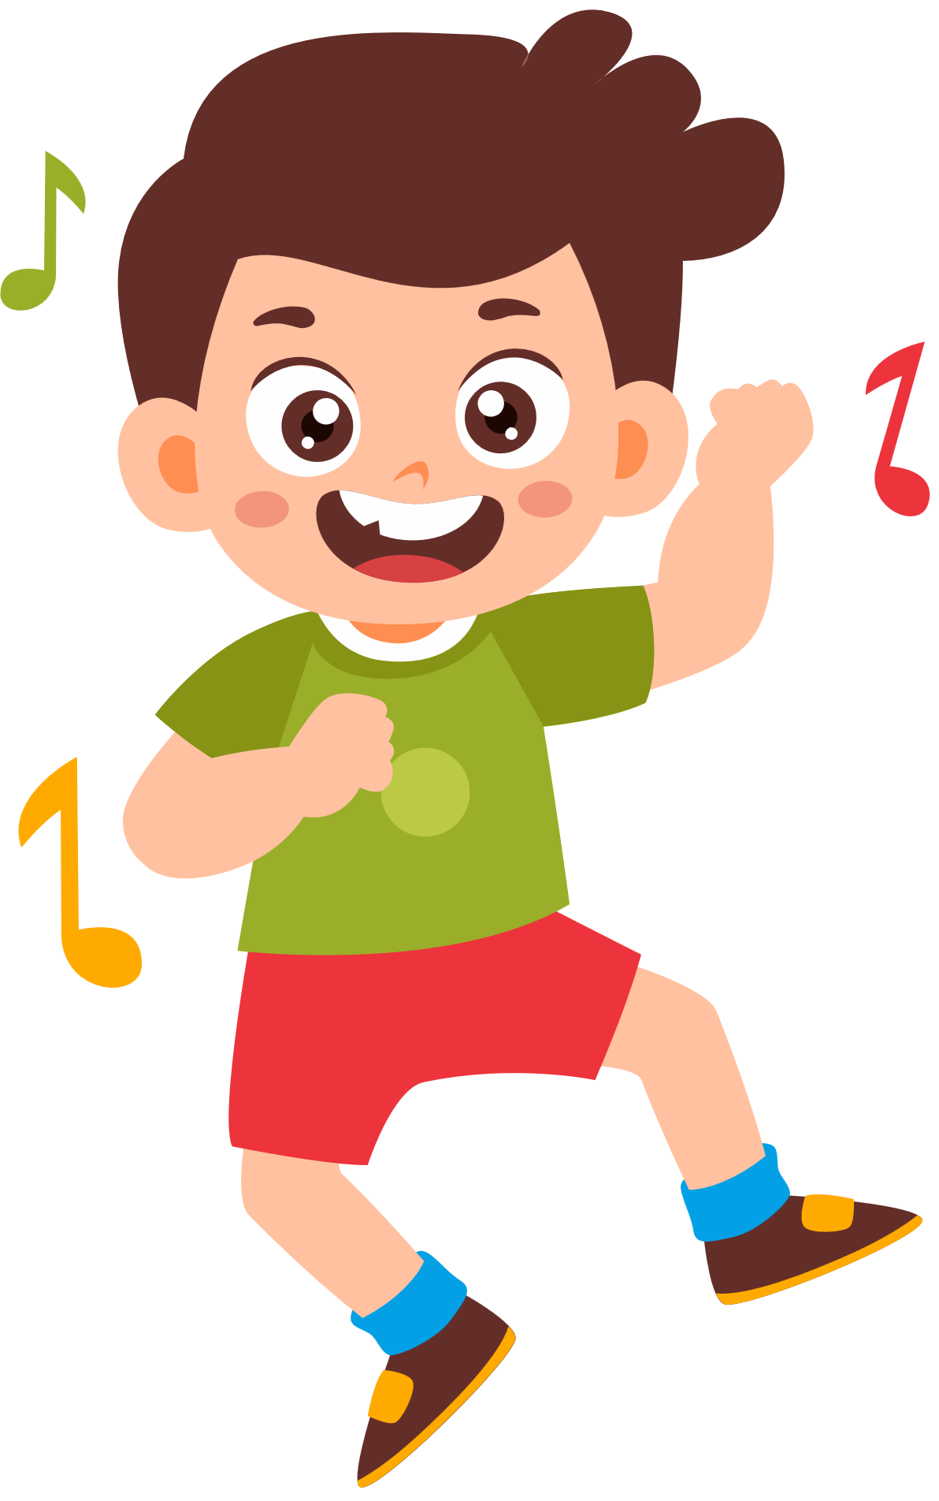
Do you dance ?

Slide 11
Do you dance ?
Yes, I do.

Slide 12

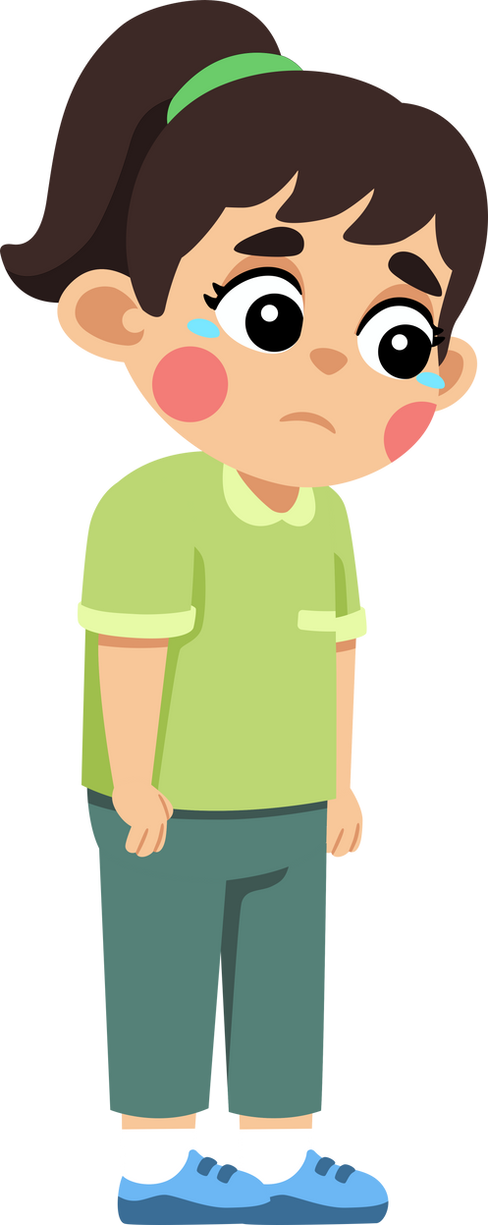
Do you slide ?

Slide 13
Do you slide ?
No, I don’t.

Slide 14
THANK YOU !

